Slide 1
Building Intelligent Applications using Bot Framework
Speaker: Anusua Trivedi
Notes:
If the links in this deck are broken please let us know (mailto: michha.r<at>Microsoft.com). Thanks in advance and enjoy learning about bots and the Microsoft Bot Framework.

Slide 2
Learning objectives

Slide 3

What You’ll Know at the End of this Session
What a bot is and is not
The major components of the Bot Framework
Deploying and working with channels
Your arsenal or toolbox
Notes:
Learning objectives for this overview module on the Bot Framework

Slide 4
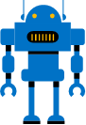
What is a bot?

Slide 5
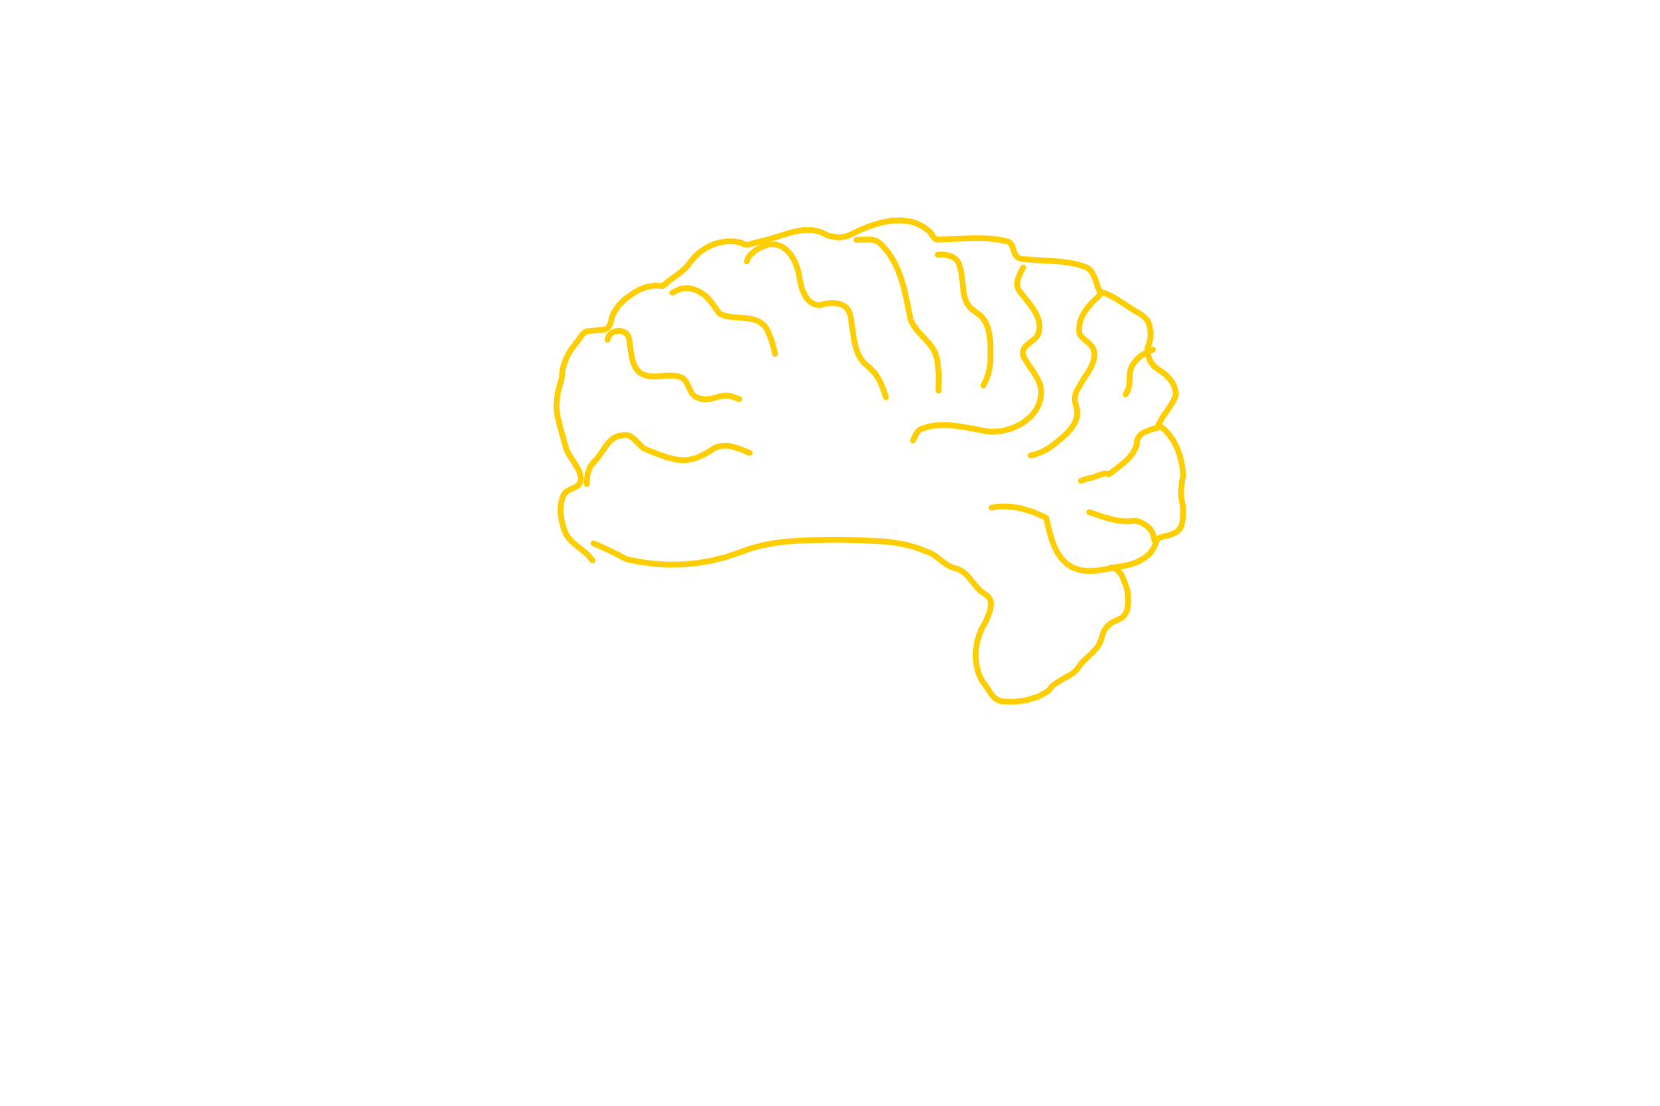
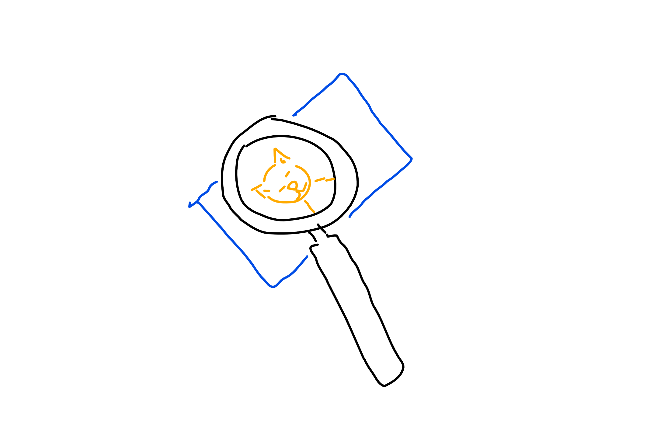
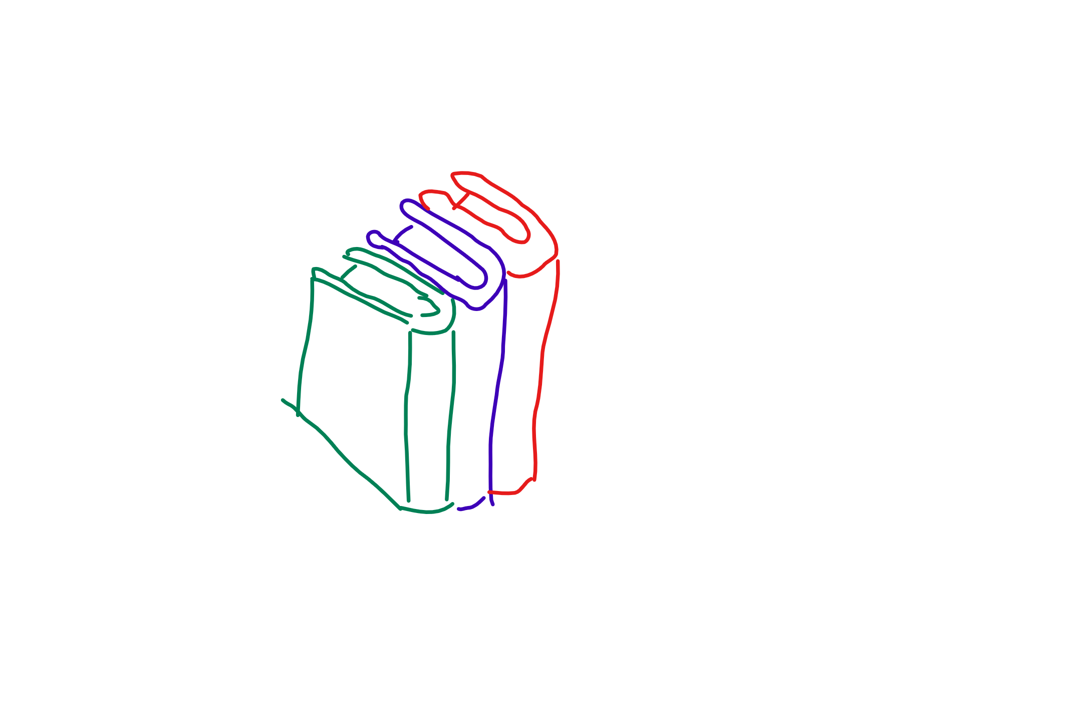
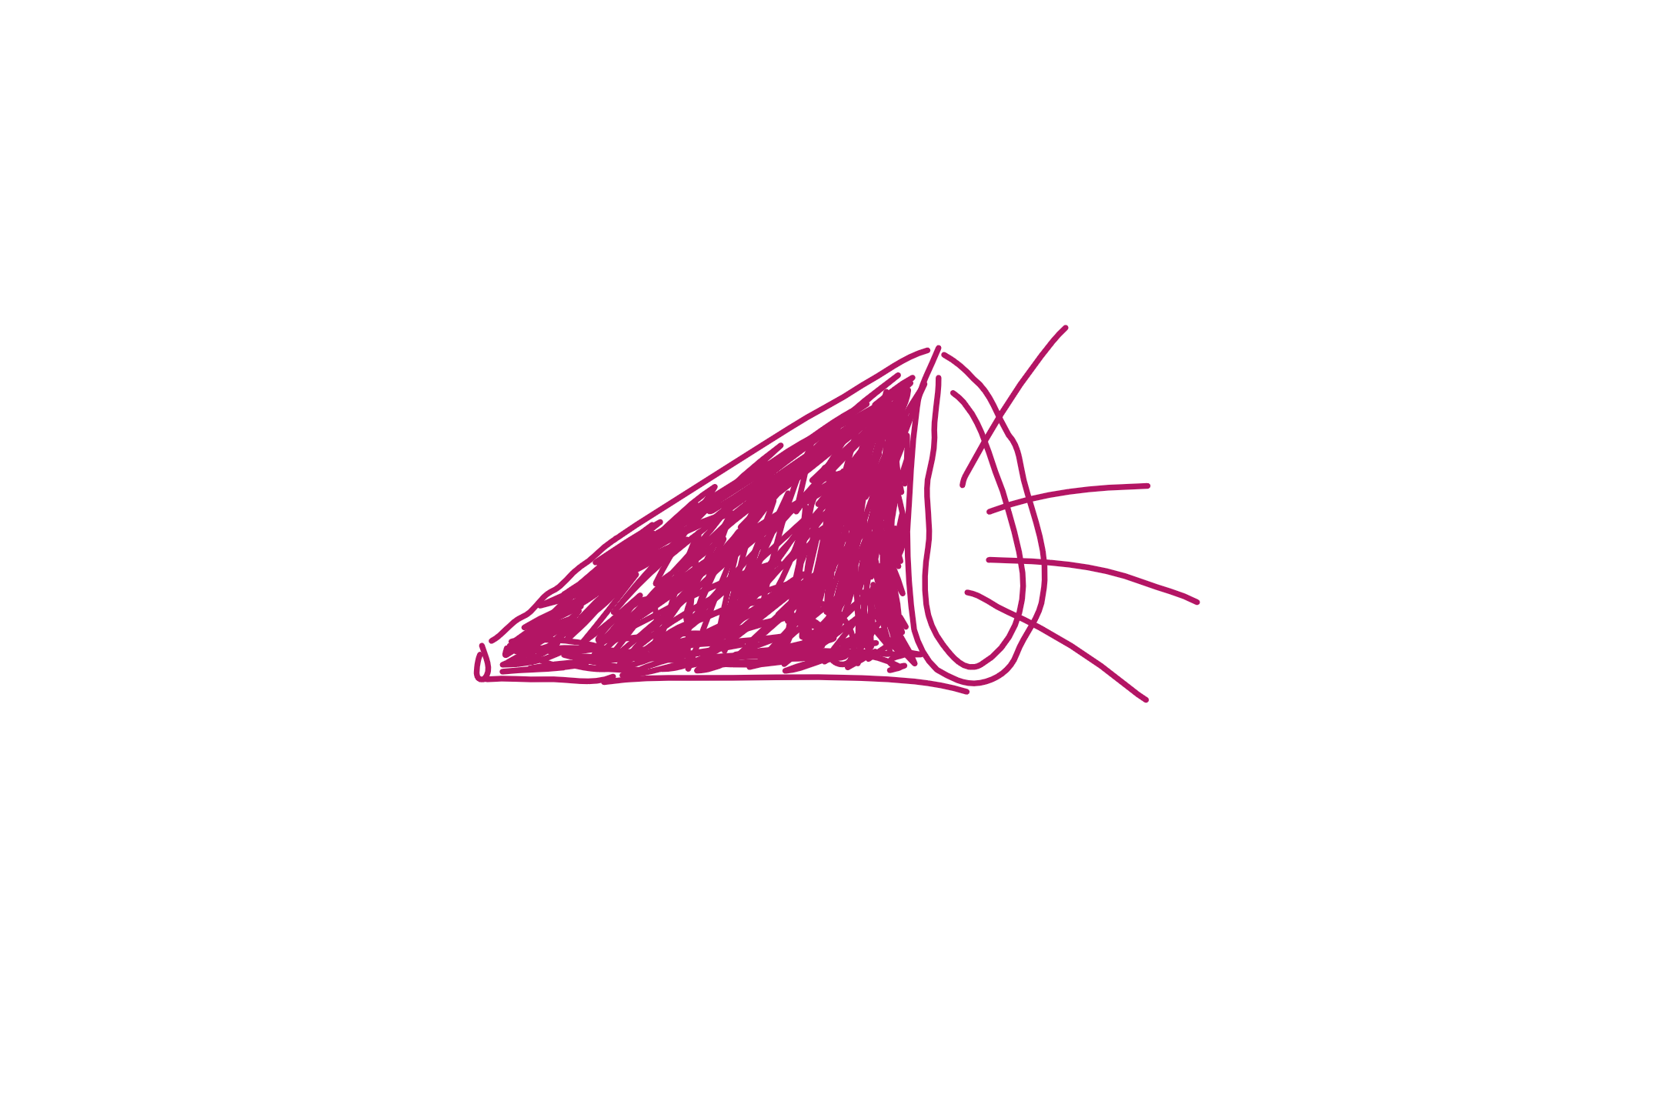
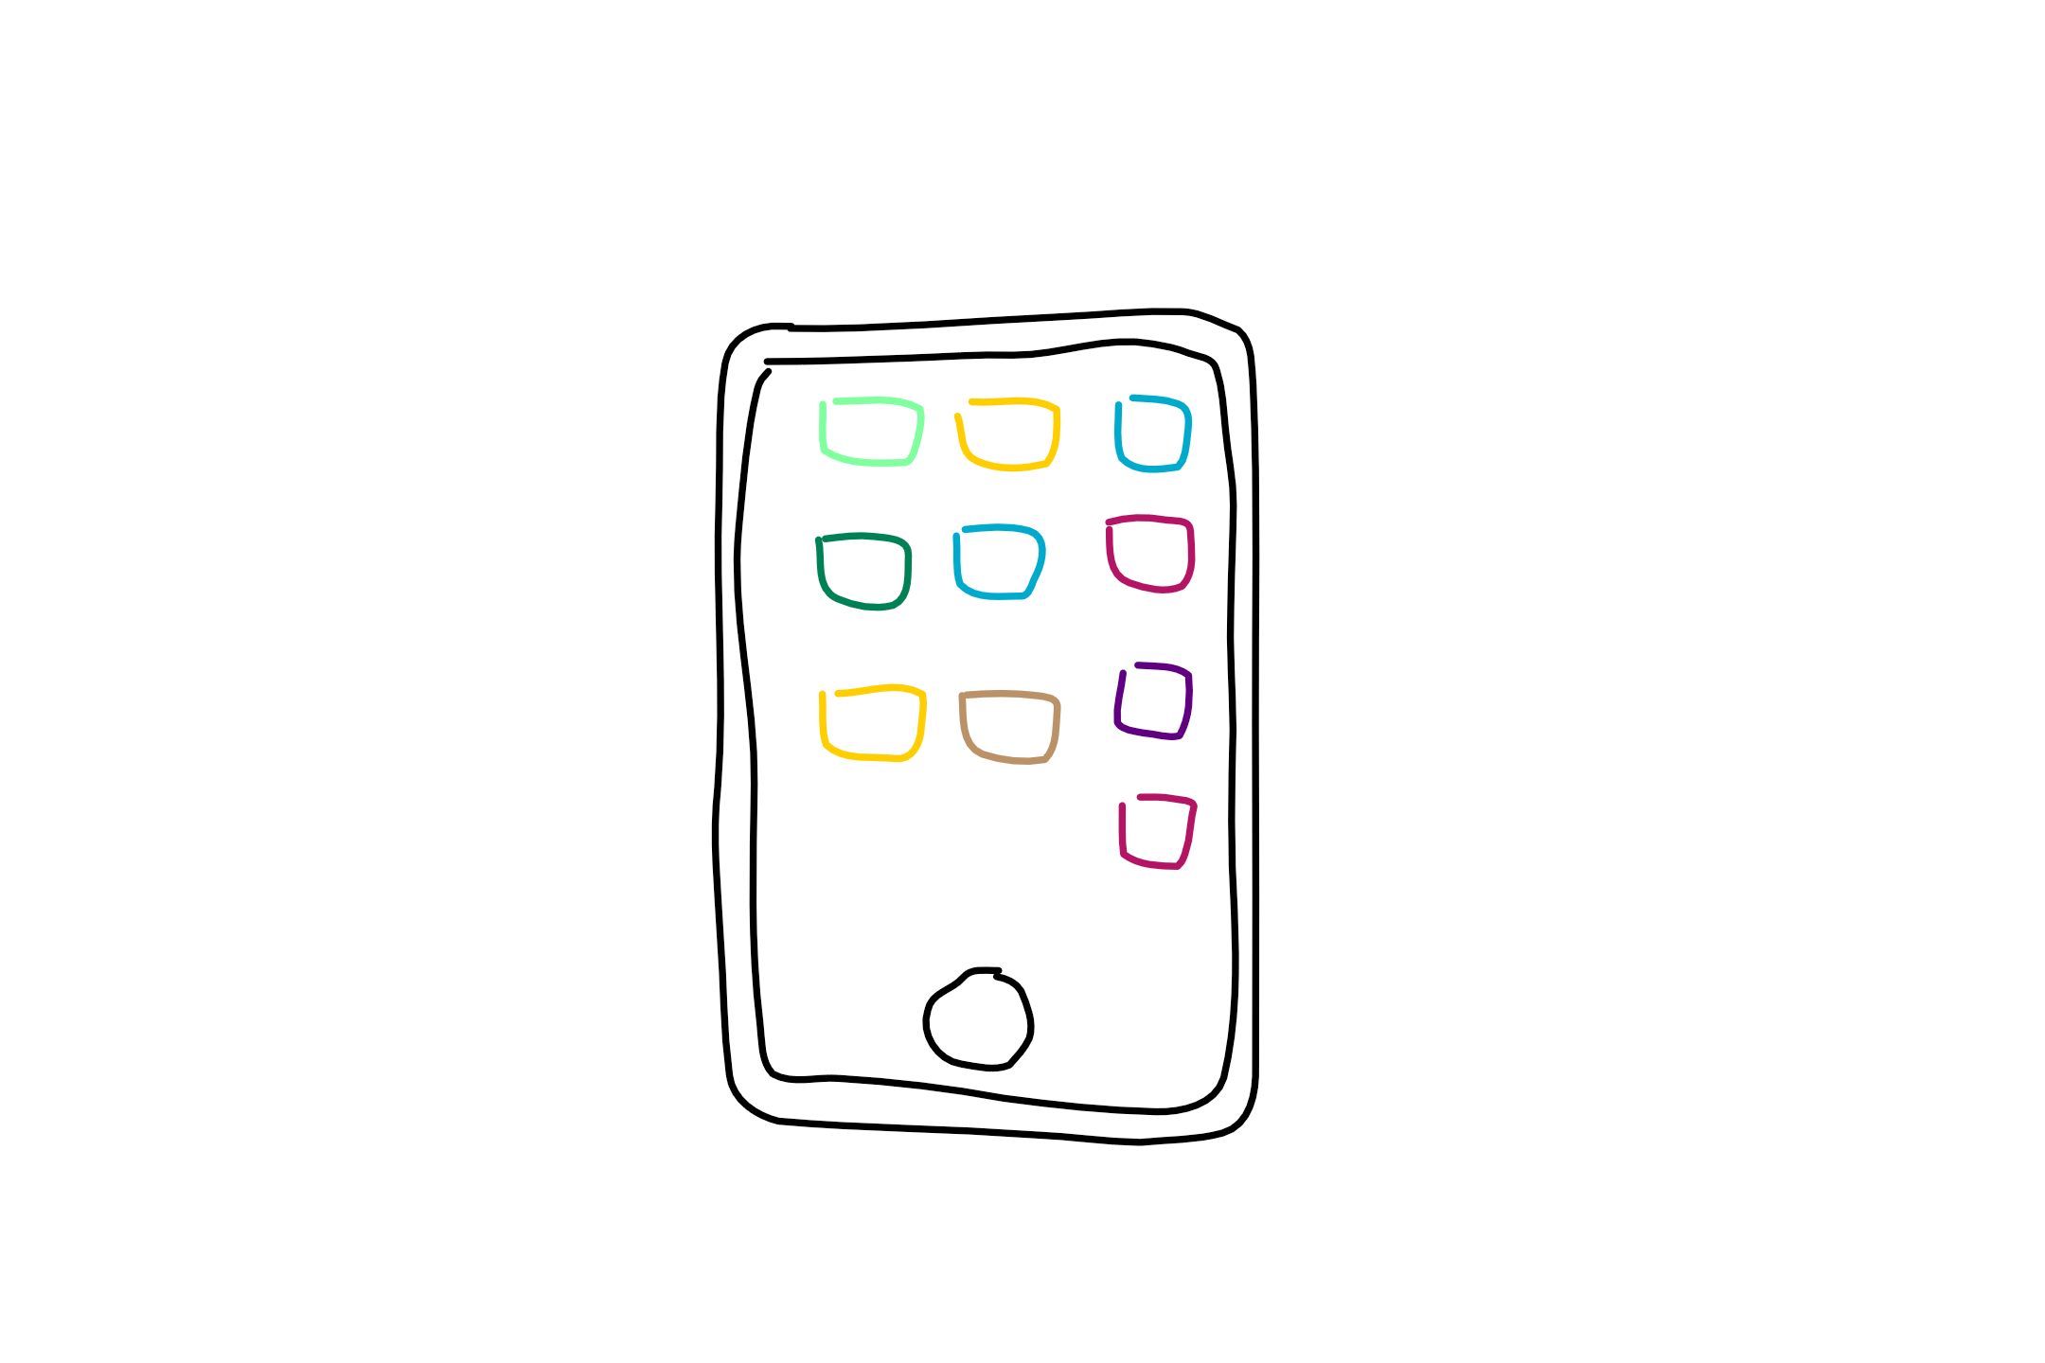
What a bot is not
It’s not AI
It’s not natural language processing only
It’s not text interfaces only
Notes:
Not AI:
Bots can be simple task automation utilities.
Example: Password reset bot. There’s no AI here. Just ask a couple of security validation questions, then reset the password.
They may have AI as well, if the scenario applies
Not only NLP:
Natural language processing has limitations, still. The more your bot depends on NLP, the worse the experience gets. Hint: Typing isn’t always the best option.
Move away from NLP as quickly as possible
“Drive” the user as much as you can (menus, choices, etc). Less typing = better
Not only text interfaces:
Bot channels are evolving quickly to support richer experiences: Media, buttons, custom controls. These are here or on their way. Text is not known to the best experience for everything.
Examples:
Skype allows audio and 3D bots as well.
Slack, Facebook and Skype have buttons/custom UIs

Slide 6
What is a bot?
Simply put, a bot is an application that performs an automated task. That’s it.
Notes:
Siri, Cortana, the old-school MS Clippy and even AOL’s SmarterChild are some examples. Essentially, bots perform automated tasks that are generally REPETITIVE for humans to do. We want to make life easier for the end user of the bot.
Bots are apps.
They can:
Exist in different channels and across platforms.
Do anything from simple task automation like taking food orders to leveraging sophisticated deep learning algos as is used by CaptionBot (https://www.captionbot.ai/ which describes the contents of an image how a human would) and otherAI-esque capabilities.
What a bot can do is only limited to the APIs your bot uses.
Bots don’t have to leverage the MS Bot Framework (e.g. MimikerAlarm https://www.microsoft.com/cognitive-services/en-us/mimickeralarm, an app for waking you up), but the Framework makes dev and deploy much simpler and faster for.

Slide 7
What types of bots are there?
Notifiers
Reactors
Responders
Conversationalist
Complexity
Notes:
Based on this blog post: http://willschenk.com/bot-design-patterns/?imm_mid=0e50a2&cmp=em-data-na-na-newsltr_20160622 about different bot types and the definitions of these.
Notifier - simply broadcast messages aka push bot e.g. ping me when there's a interesting tweet about Hadley Wickam
Reactor - reacts to messages on service, but doesn’t persist anything (message, user state, location) e.g. send me the stock price for a stock I specify, but don't remember me or what I say
Responder - reacts to messages on service, persists message and knows who I am e.g. send me today's weather forecast for a city, use my user name on this channel, and remember what cities I choose
Conversationalist – reacts to messages, persists messages, knows who I am, knows about the “place” I’m at (channel, room,…), knows the state of the conversation e.g. send me today's weather forecast for a city, use my user name on this channel, remember what cities I choose, format it nicely for this channel, and if the conversation is old, archive it and send as email.
From “Bot Design Patterns”: Questions that help us formulate what kind of bot we might want or need:
Do they react to messages?
Do they know who they are talking to?
Can they learn from what was said?
Do they know where the conversation is taking place?
Do they remember the overall conversation?

Slide 8
The bot life cycle
1. Tangible problem
5. Improve on current bot
2. Ask: How is bot better way
4. Collect bot metrics
3. Get around heavy use of NLP
Notes:
Start by asking what problem are we trying to solve. Refine until it looks like a tangible problem and not “magic”
Ask how a bot will be a better experience. User experience is EVERYTHING
Avoid too much natural language. Careful with unrealistic expectations. Natural language recognition is limited. Menus work great. Commands work great. Buttons, etc.
You can only analyze and improve your bot if you’re collecting metrics for it
Iterate, improve

Slide 9
Consideration when going the route of a bot
Provide as much value to the user as you can
Participate in a productive conversation (minimize complexity)
Emotion, variety and personality are vital (even if Markov Chain bot)
Utilize the interaction patterns of the messaging canvas and the mobile OS
Craft an engaging welcome message
Be judicious with data and message frequency (avoid “push bots”)
Give feedback (e.g. confirm intent)
Keep the user in control (e.g. turn on/off updates)
Be nice and do the right things (e.g. operating with integrity and respectful and considerate of everyone)
Notes:
From: https://docs.botframework.com/en-us/directory/best-practices
This may have been in your mind before this tutorial. Ethical and societal considerations as well in an article by Satya Nadella: https://www.linkedin.com/pulse/partnership-future-how-humans-ai-can-work-together-solve-nadella

Slide 10
Here enters the Bot Framework

Slide 11
The Benefits of the Bot Framework
For developers
Bots are more capable nowadays so more functions
Bot Builder SDKs or custom code – you have choices
Faster testing, dev and deployment
Easy integration with the cloud
Growing community
For end users
User choice of channels
Users have trust and control of their data
New experiences
For businesses
Broad access to their customers and new experience
Reduced cost of development
High quality bots
Notes:
For developers
Bots are more capable because of supporting services i.e. MS Cognitive Services and BF State Service
Bring your own bot or build your own bot with the Bot Builder SDKs
With SDKs and sample code on github
Smooth cloud deployment and integration
Big community (open source community, issues, gitters, stackoverflow – active and responsive)
For end users
Users can choose from a variety of conversation channels
Users have trust and control of their data – encrypted and accessible anytime
Frictionless fun or at least makes something much easier
For businesses
Broad access to their customers where they already are conversing giving them new experiences
Reduced cost of development – just faster with SDKs and builtin functionality like dialog handling and language understanding
High quality bots (big support and dev community) as well as, bots are reviewed after publishing and surfaced on Bot Directory

Slide 12
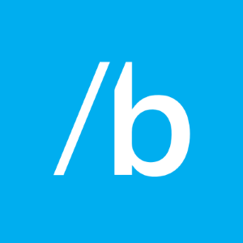


Bot Builder SDK
Bot Framework Developer Portal
Bot Directory
Dev
Connect
Publish
Notes:
Bot Builder is itself a framework for building conversational applications (“Bots”).
The Bot Builder SDK is an open source SDK hosted on GitHub that provides everything you need to build great dialogs within your Node.js-, .NET- or REST API-based bot.
The Bot Framework Developer Portal lets you connect your bot(s) seamlessly text/sms to Skype, Slack, Facebook Messenger, Kik, Office 365 mail and other popular services. Register, configure and publish.
The Bot Directory is a public directory of all reviewed bots registered through the Developer Portal.
NB: Bot builder and bot connector SDK now one in V3 of framework: http://docs.botframework.com/en-us/support/upgrade-to-v3/#botbuilder-and-connector-are-now-one-sdk

Slide 13
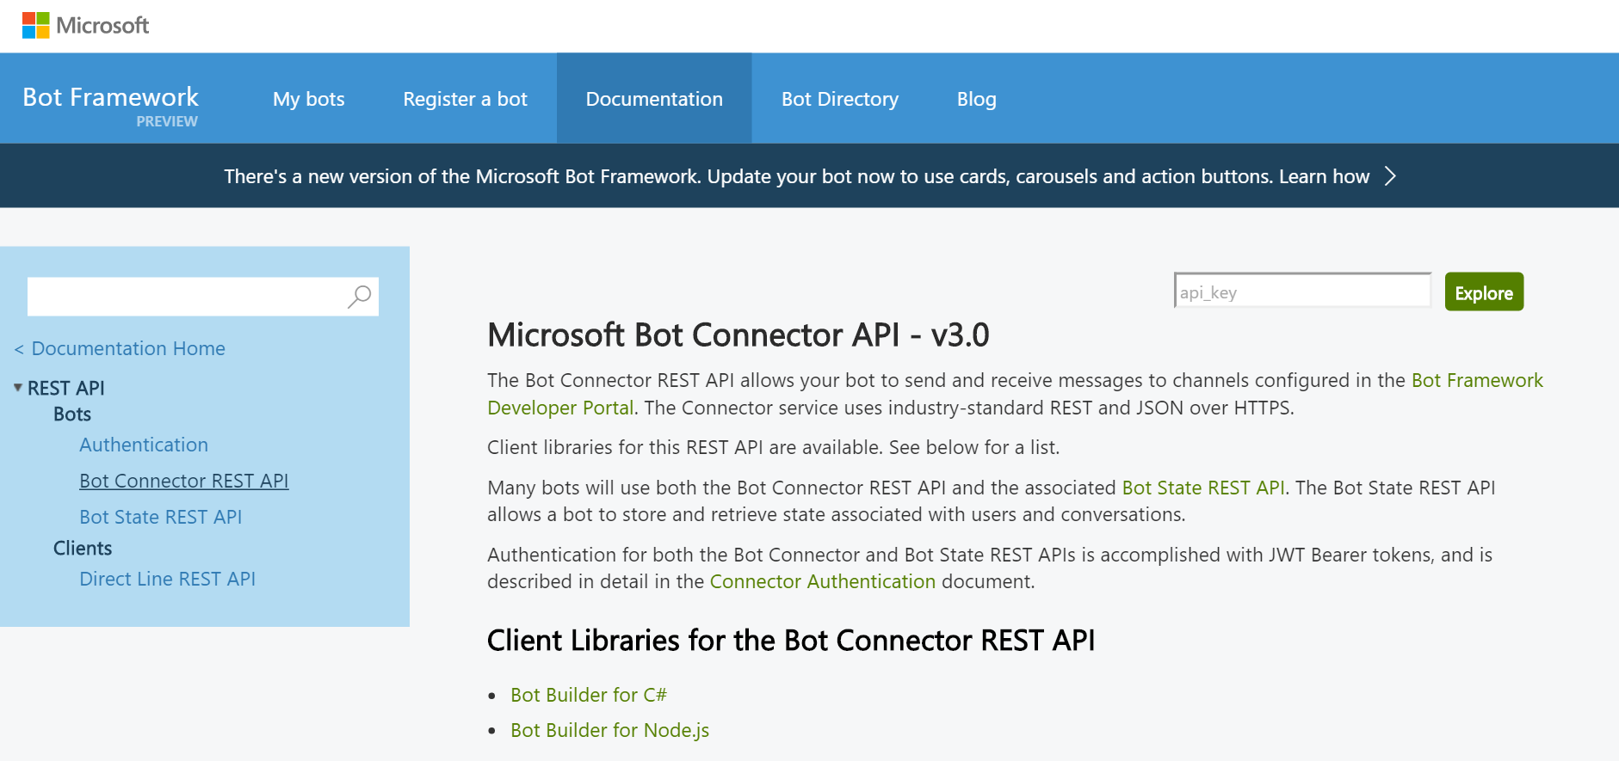
Bot Builder: Development Kits and REST
Bot Builder SDKs for:
.NET framework for C#
Node.js
And there’s also
REST and REST State APIs
Notes:
SDKs infographic: http://docs.botframework.com/en-us/images/faq-overview/bot_builder_sdk_july.png

Slide 14
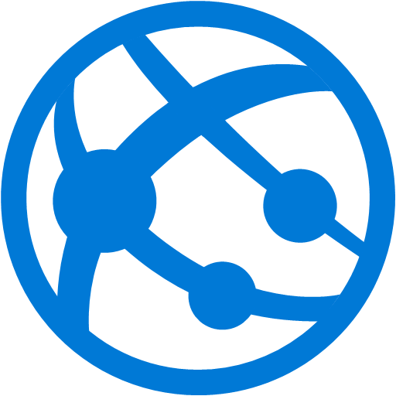
Developer Portal: what registration does for you
Your bot’s web service in the cloud
MS Bot Framework Connector
Notes:
Expose a Microsoft Bot Framework-compatible API on the Internet, then the Bot Framework Connector service will forward messages from your Bot to a user, and will send user messages back to your Bot.

Slide 15






State Service: types of bot data stored for us
User-conversation data
Conversation data
User data
Dialog data
This data is currently stored for free for you within the Bot Framework State Service.
However, you may bring in your own data source (format: key-value store)
Notes:
User data – globally available for user across all conversations
conversation data – stores globally for a single conversation (many users could be involved)
User-conversation data – stores globally conversation data for a user (But private to just that user)
Dialog data as well – persists for a single dialog (helpful for temp data in a waterfall set of steps)

Slide 16
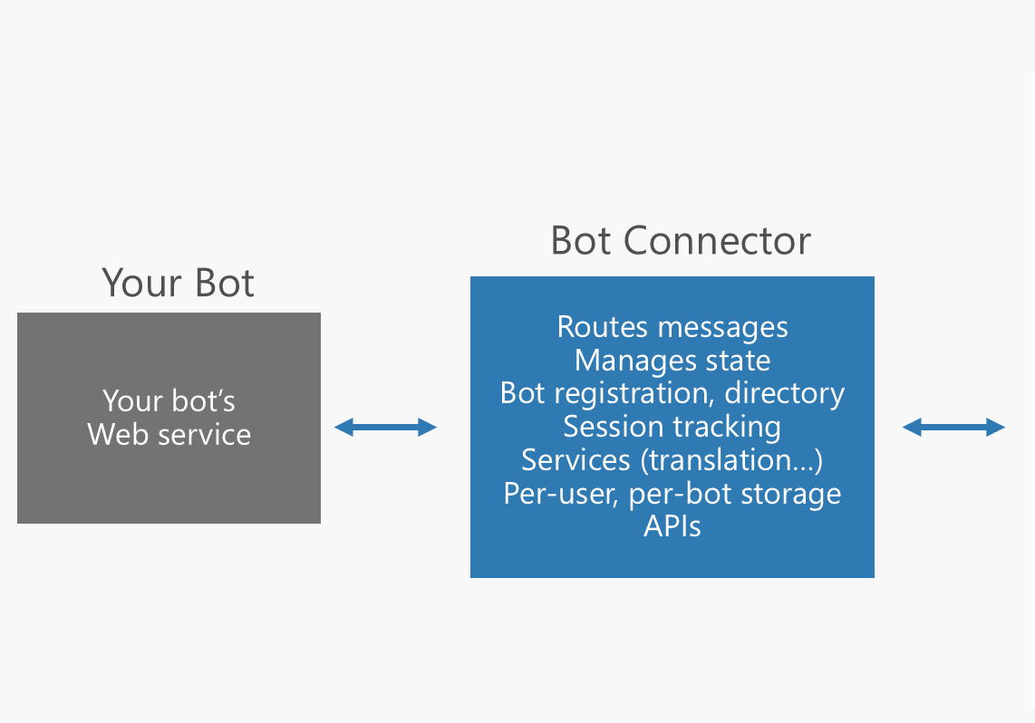
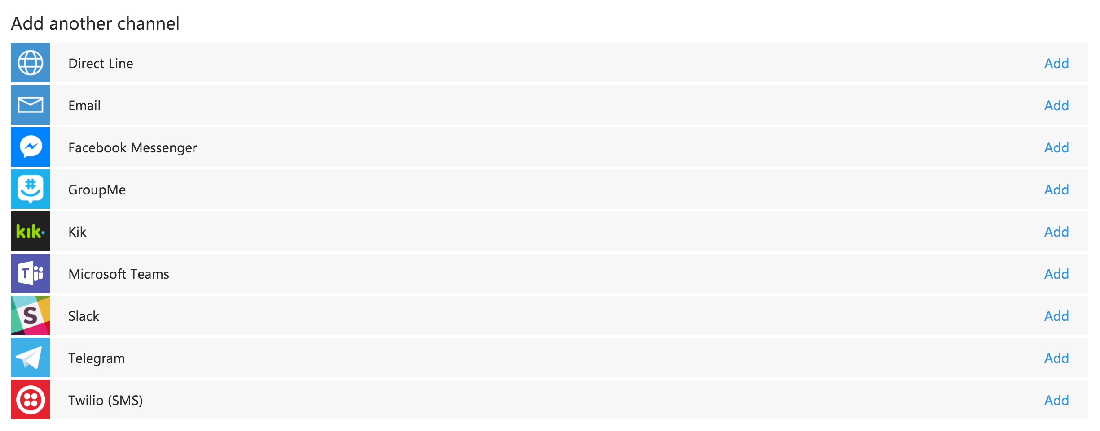
What is the Bot Connector?
Notes:
It’s part of the Bot Builder SDK
http://docs.botframework.com/en-us/csharp/builder/sdkreference/gettingstarted.html#channels

Slide 17
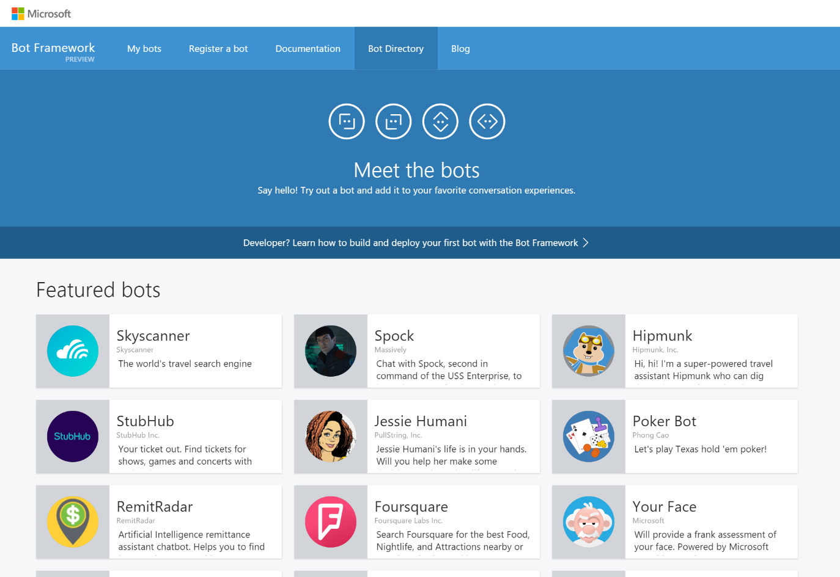
Bot Directory
Public Directory of Bot Framework Bots
Discover, try, and add bots from here with no added configuration
Bots are public at developer discretion; must be reviewed
Searchable here
Notes:
Bots must be submitted for review and approved in order to appear in the directory
As of Nov. 17, 2016 there are 94 bots in the directory from MS and other companies

Slide 18
Working with channels

Slide 19
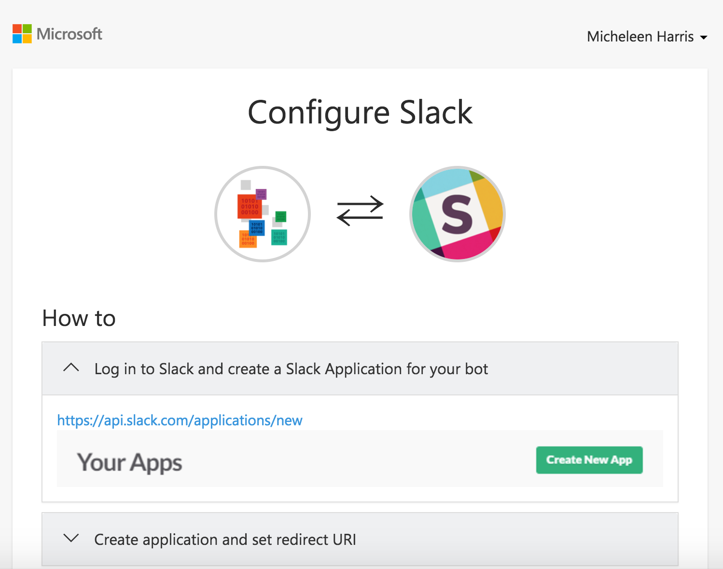
Adding a channel
Skype is added by default
Instructions are laid out
Notes:
Often, the most time will be spent configuring your credentials as a developer on the target service, registering your app, and getting a set of Oauth keys that Microsoft Bot Framework can use on your behalf

Slide 20
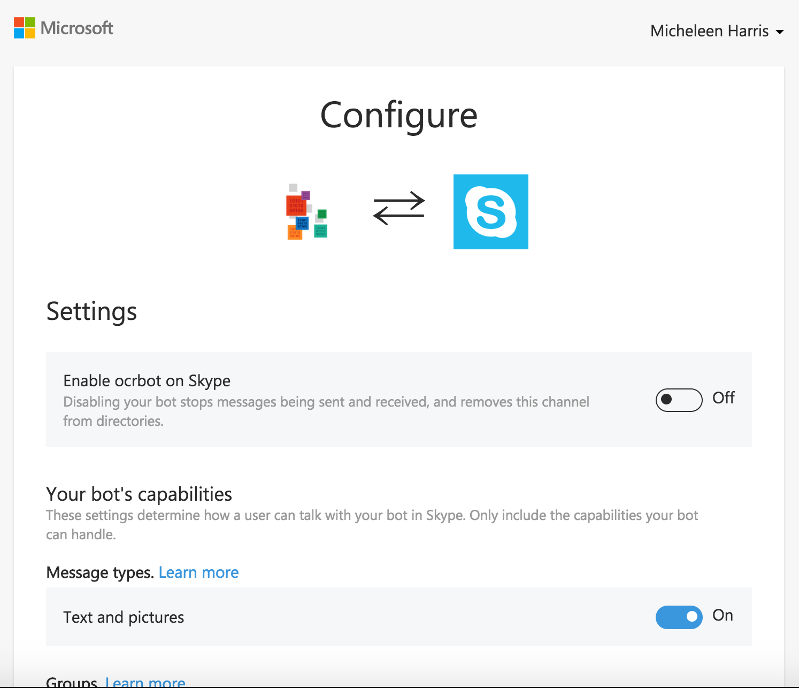
Editing a channel
Skype for instance, through configuring we can:
Disable/enable globally
Turn on/off group messaging
and more

Slide 21
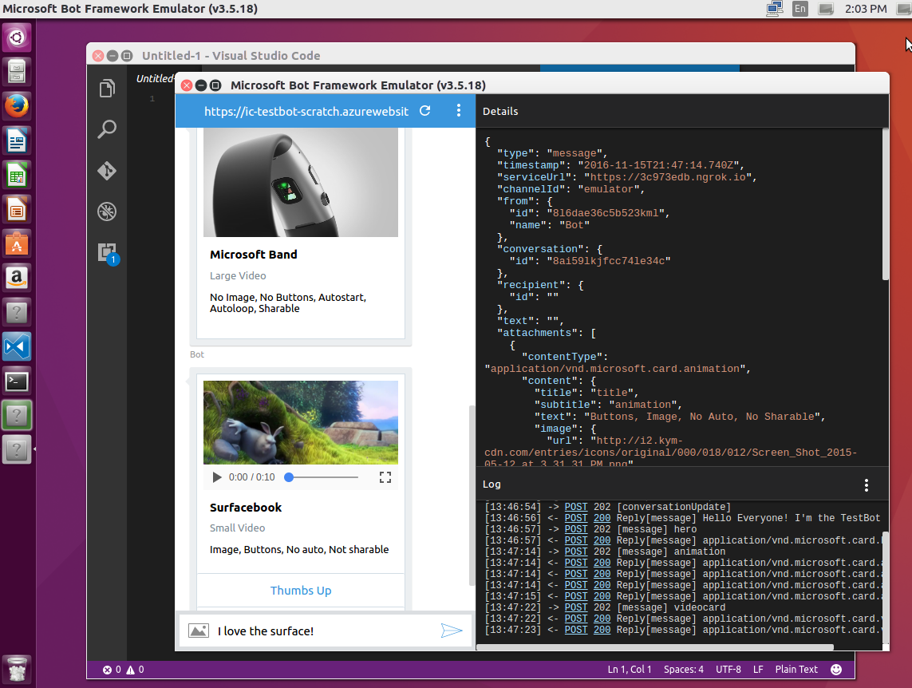
The BF Emulator
New Support for Mac, Linux and Windows
New All the Bot Framework card types are supported
New Save multiple profiles for when you’re working online and off
New Simplifies configuration when you’re working with ngrok
New Uses the webchat control for higher fidelity layout and consistency with the webchat experience
Notes:
Emulator purpose:
Send requests and receive responses to/from your bot endpoint on localhost
Inspect the Json response
Emulate a specific user and/or conversation

Slide 22
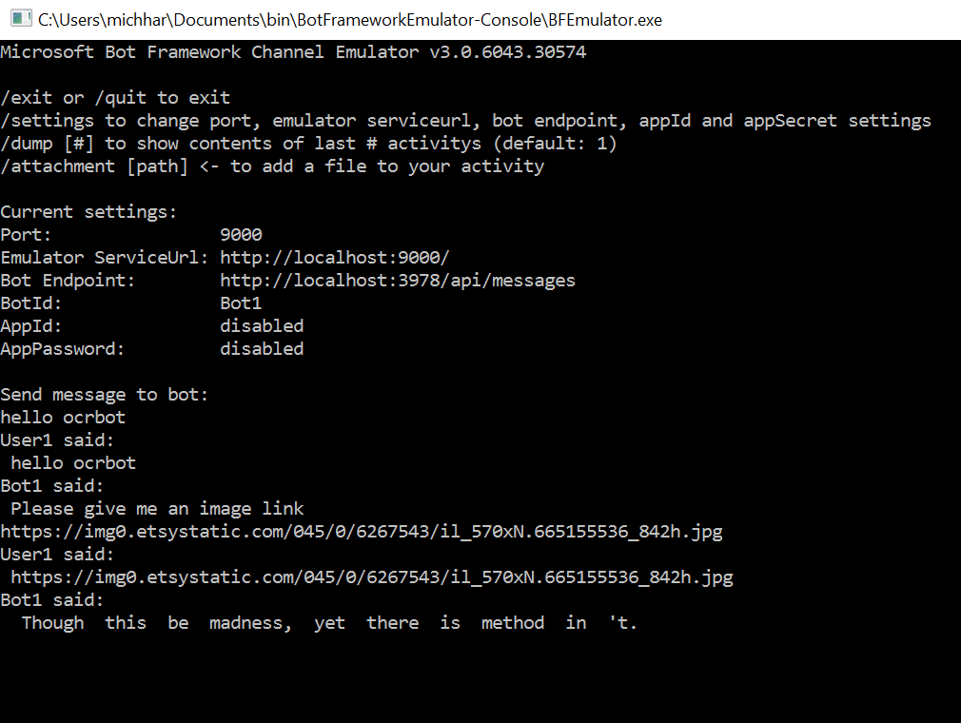
Test conversing in BF Command Line Emulator
Using the Emulator, you can:
Send requests and receive responses to/from your bot endpoint on localhost or deployed in cloud
Inspect the JSON response
Emulate a specific user and/or conversation
Download tool for free
Notes:
https://docs.botframework.com/en-us/tools/bot-framework-emulator/#mac-and-linux-support-using-command-line-emulator

Slide 23
Node App: get the Bot Builder module from command line
As easy as:
npm install --save botbuilder
Or:
git clone https://github.com/Microsoft/BotBuilder.git
cd BotBuilder/Node
npm install
Notes:
We will set up after the Cognitive Services Overview
https://docs.botframework.com/en-us/node/builder/guides/core-concepts

Slide 24
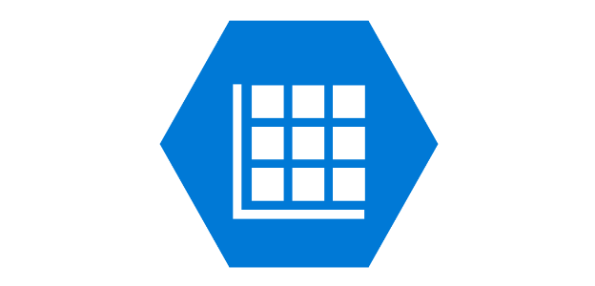



Components of deploying your bot
Web service
Bot Framework service
Data store service
Local project
User
Channel
Notes:
Steps:
The developer writes their bot code, leveraging the BF libraries in the SDKs and APIs available
Create an endpoint for the bot to talk to in the cloud
Connect to the Bot Framework service (Connector and State services)
Pass user and conversation data between channel and Framework (data store in the state service, managed by the BF)
The user interacts with the bot on a channel of their choosing

Slide 25
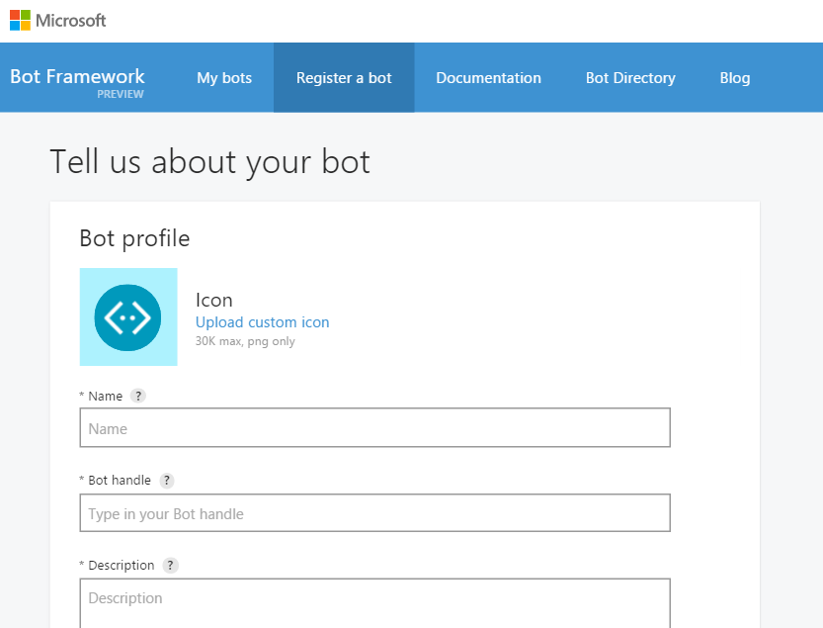
Register a Bot in the Developer’s Portal
Notes:
Register on the developer portal by clicking the ‘Register a bot’ link: https://dev.botframework.com/bots/new
Name: TemplateBot
Bot Handle: templatebot (for referencing in Bot Directory and name for bot on web chat, NOT the app’s URL used as endpoint)
Also, add a description here
Configuration
Remember the URL endpoint from deploying endpoint step. Should be something like: “https://botwebappname.azurewebsites.net/api/messages”
You’ll go through the “Generate App ID and password” wizard, then return to the registration page.
Go back and edit this profile anytime

Slide 26
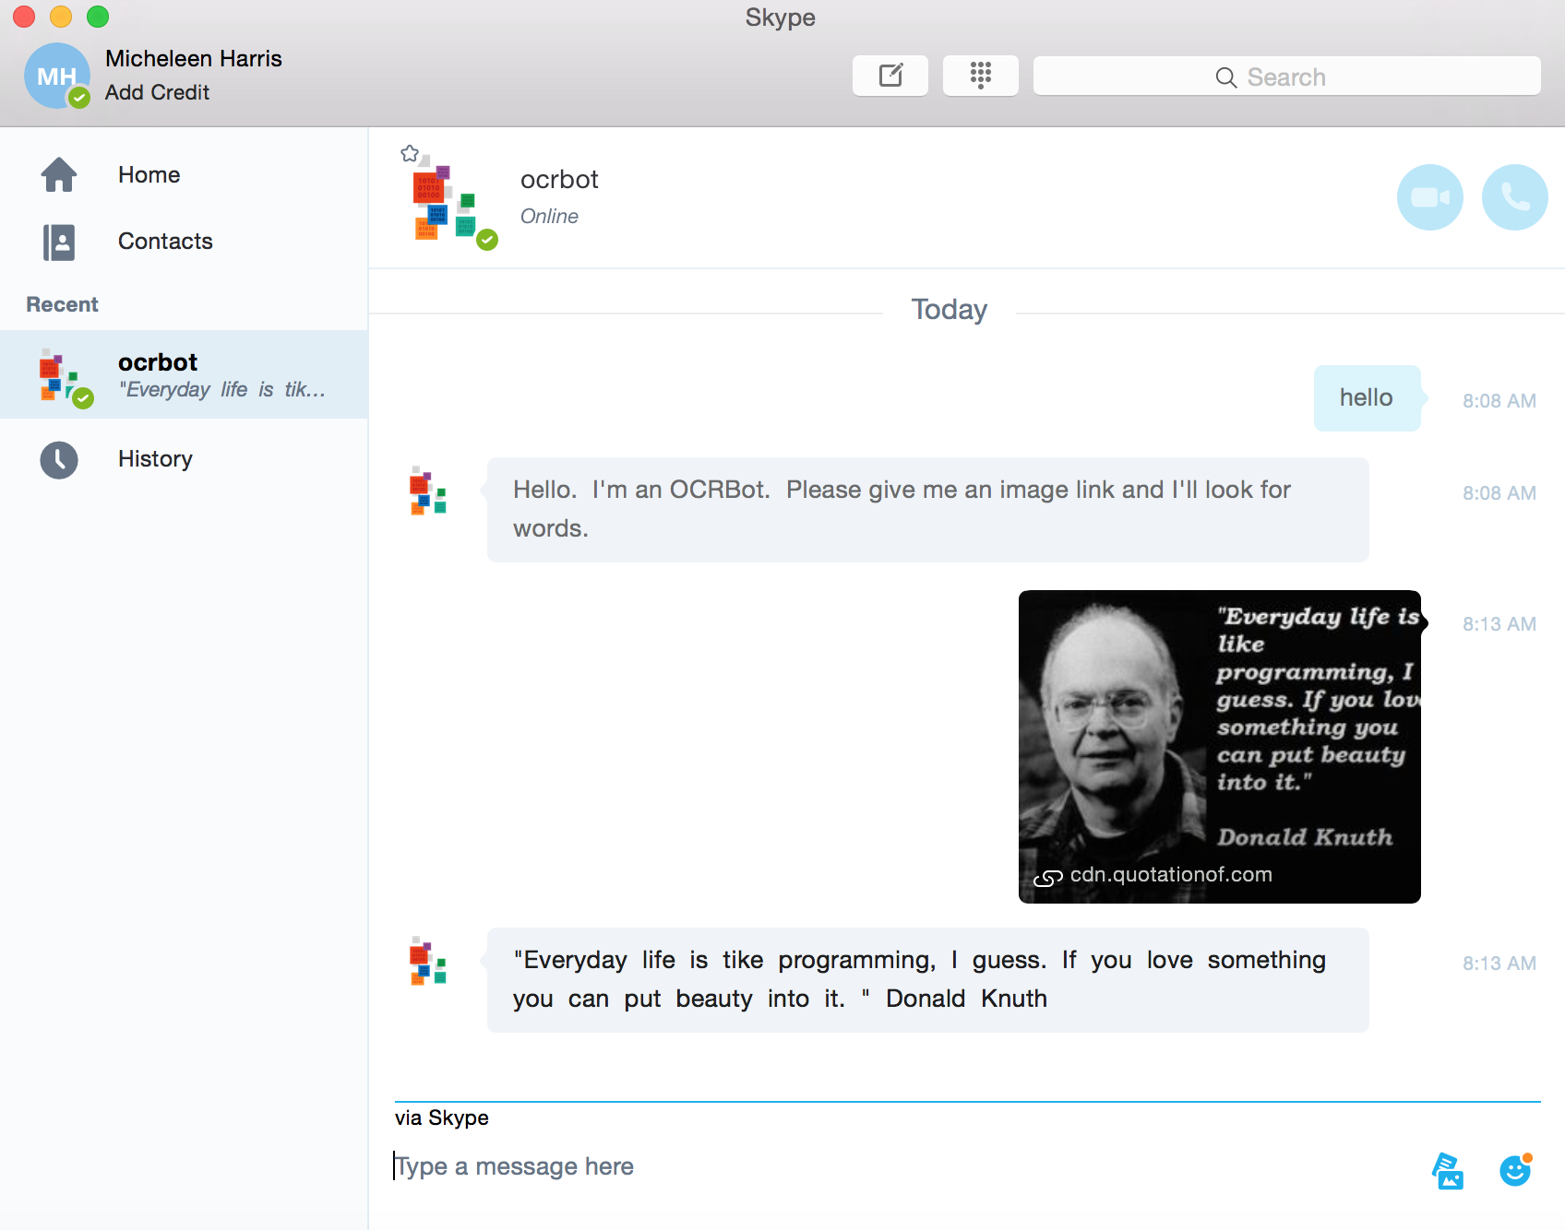
Skype channel example

Slide 27
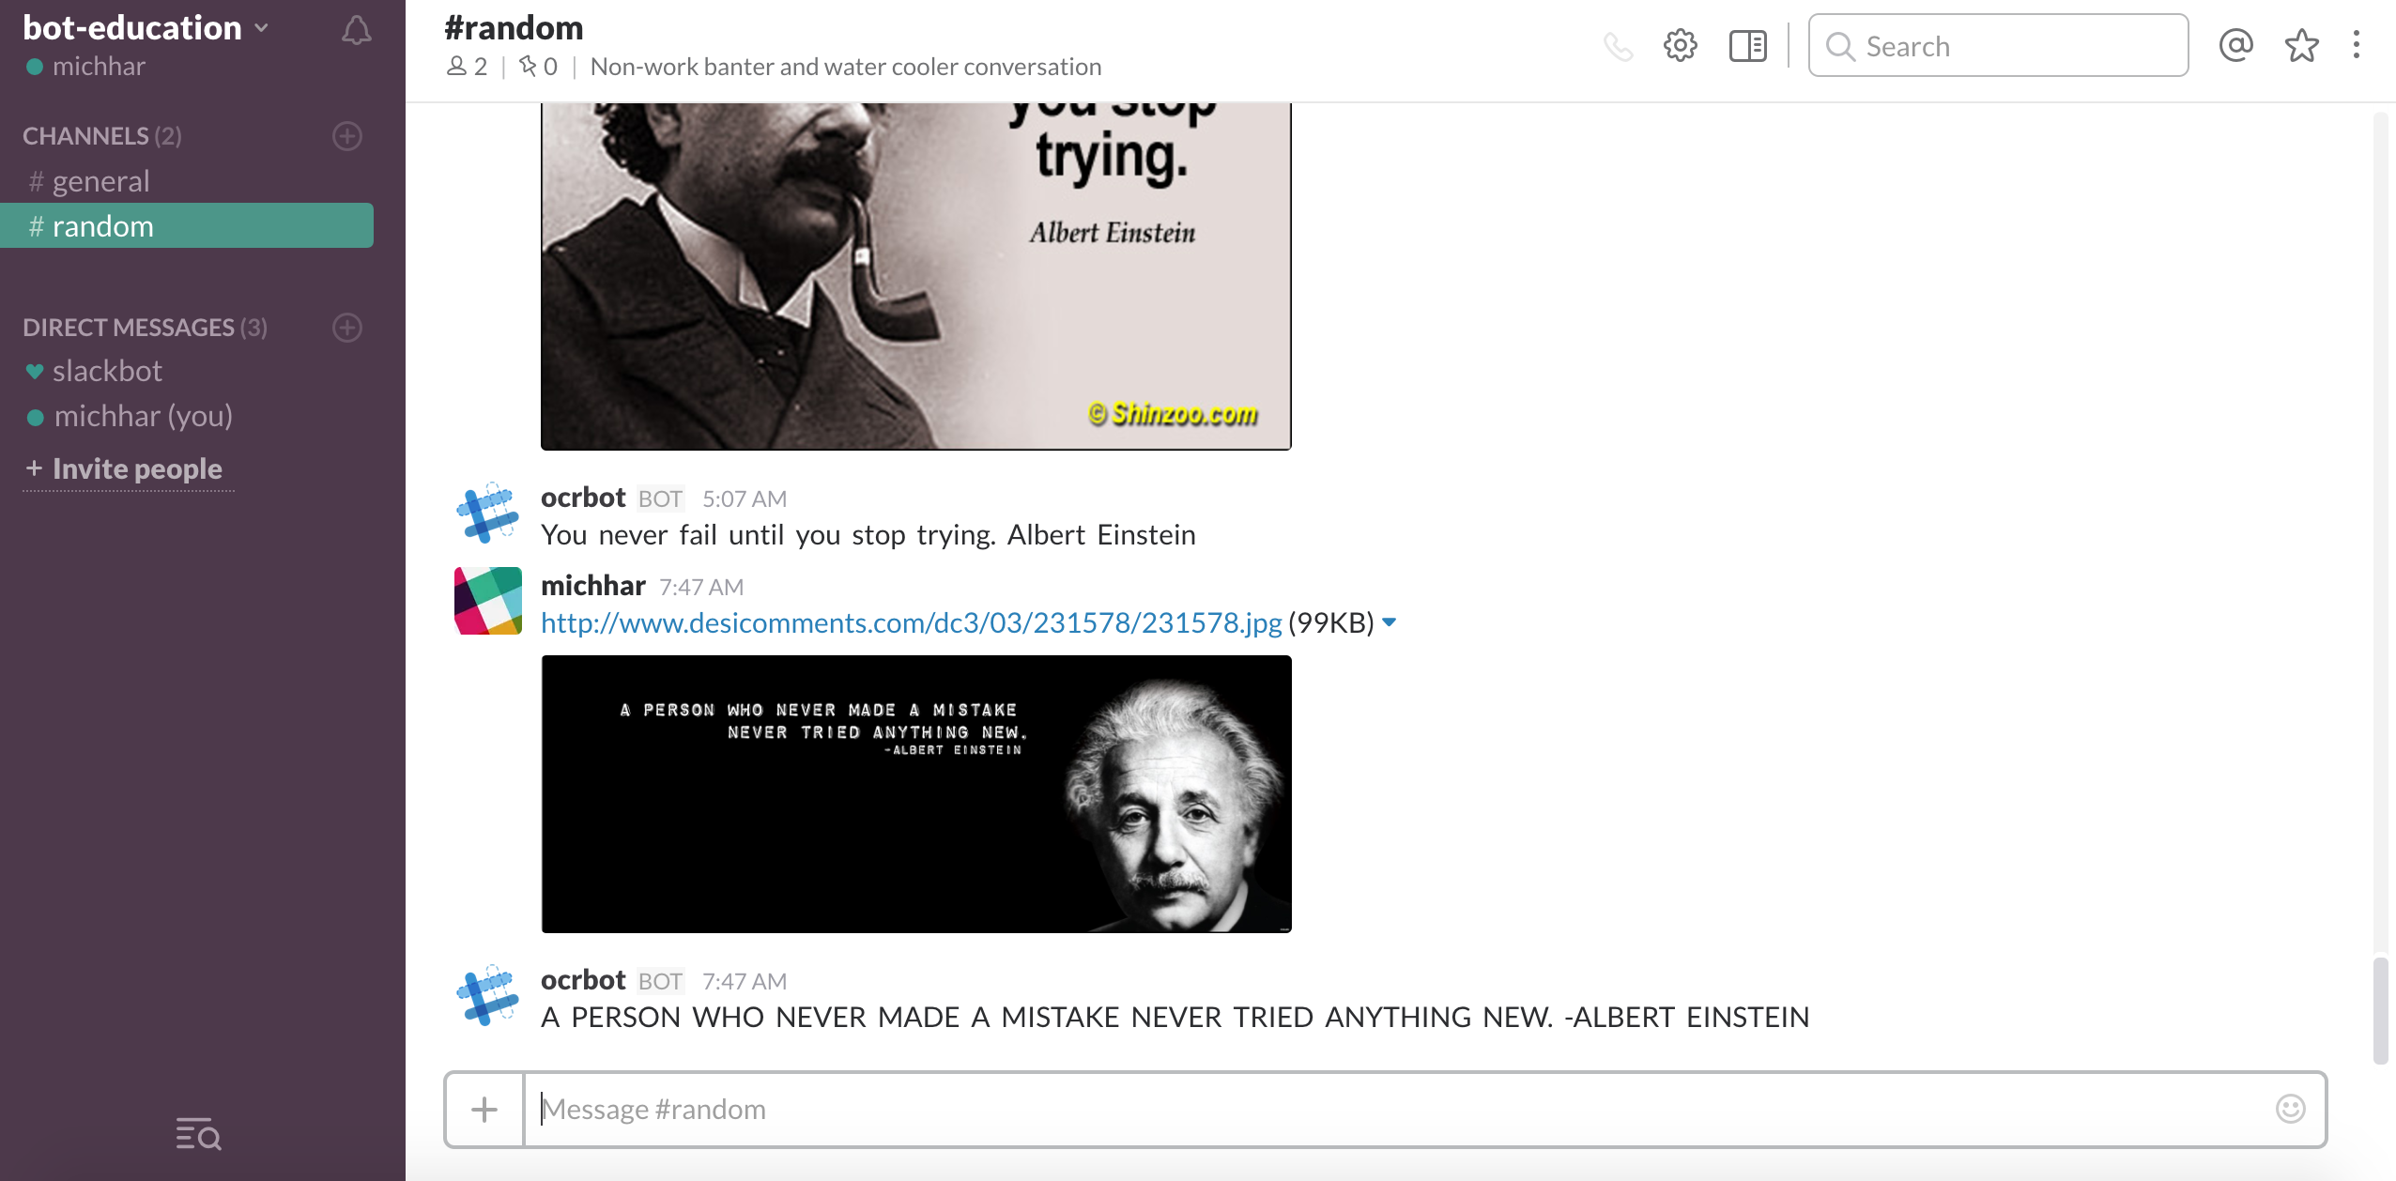
Slack channel example

Slide 28
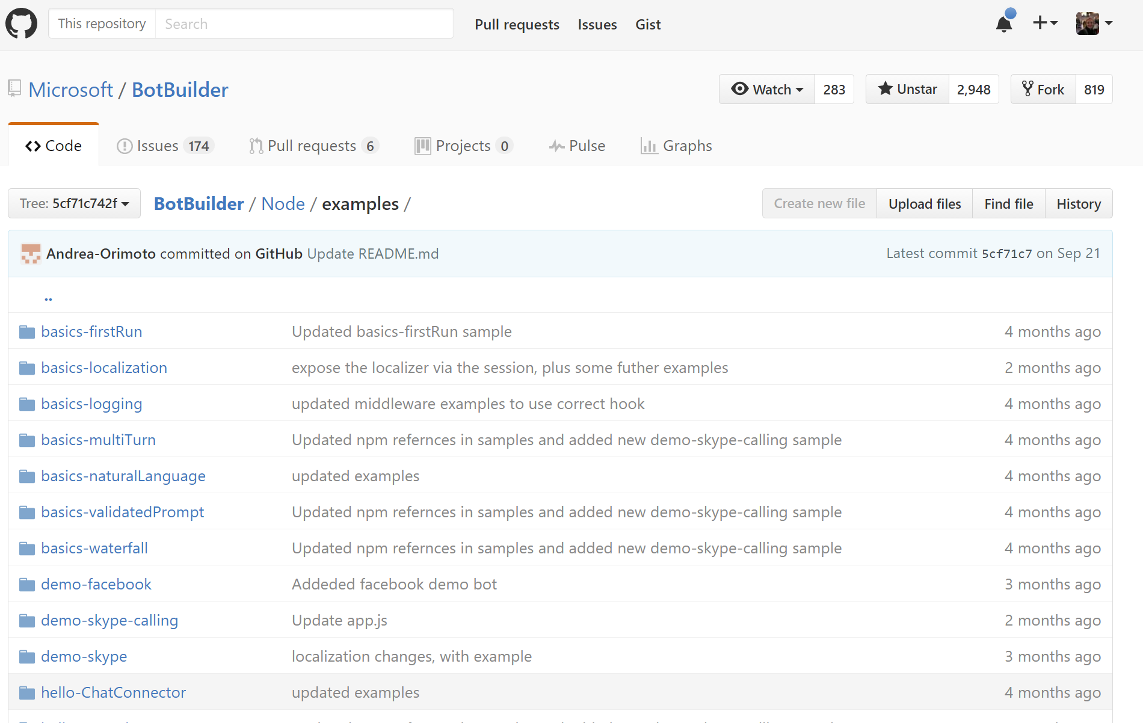
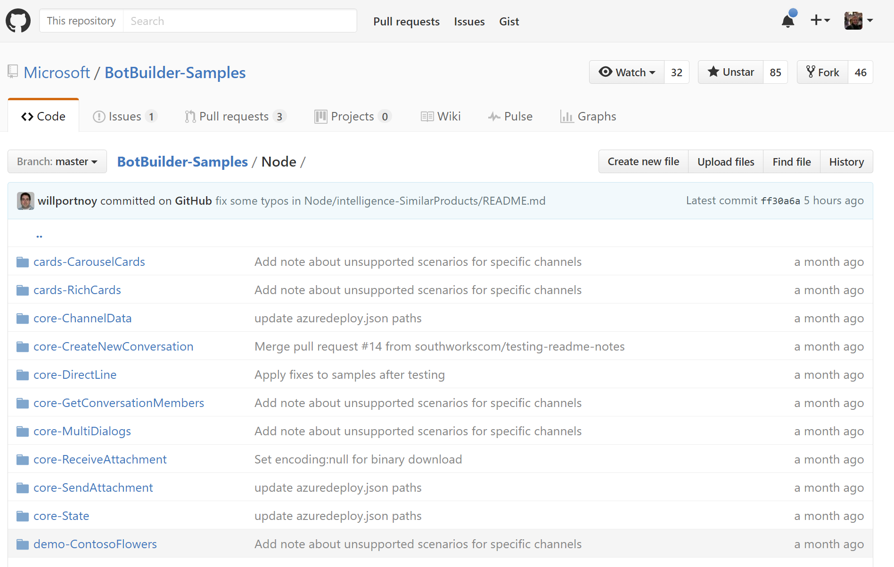
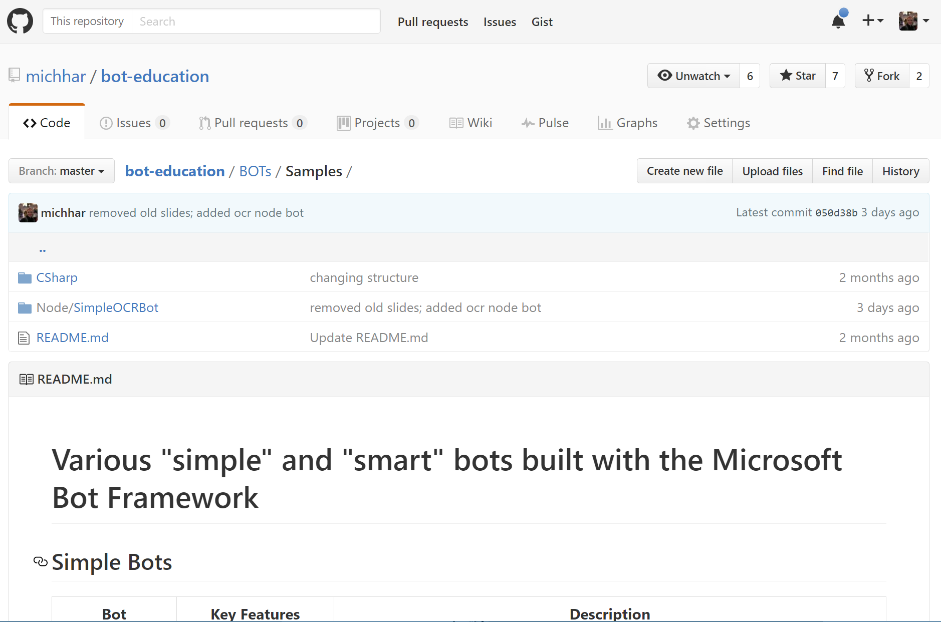
Tons of sample code on GitHub
On github from Microsoft (and elsewhere):
Notes:
https://github.com/Microsoft/BotBuilder-Samples
https://github.com/Microsoft/BotBuilder/tree/master/CSharp/Samples
https://github.com/Microsoft/BotBuilder/tree/master/Node/examples
More out there…so many, can’t list…

Slide 29
Resources
Support | Contact
Bot Builder SDK issues and suggestions | Use the issues tab on our github repo: https://github.com/Microsoft/BotBuilder/
Using a bot | Contact the bot’s developer through their publisher e-mail
Community support | Use StackOverflow, with the hashtag #botframework
Reporting Abuse | Contact us at bf-reports@microsoft.com

Slide 30

Parting thought (before our lab)
We can aim for our bots to: Be transparent and have algorithmic accountability so that humans can undo unintended harm. (Satya Nadella)
Notes:
Ethical and societal considerations taken directly from an article by Satya Nadella: https://www.linkedin.com/pulse/partnership-future-how-humans-ai-can-work-together-solve-nadella

